Slide 1
Module 1: Introduction to OS

Slide 2
Introduction to Operating Systems: Virtualizing the CPU, Virtualizing the memory, Concurrency, Persistence, Design Goals. Components of an OS, Types of OS, Operating System structure - Simple structure, Layered approach, Microkernel, Modules, Generalized view of System Calls, System boot process.

Slide 3
What is an Operating System?
An operating system is a software that manages a computer’s hardware.
It also provides a basis for application programs and acts as an intermediary between the computer user and the computer hardware.

Slide 4
Operating system goals
Execute user programs and make solving user problems easier
Make the computer system convenient to use
Use the computer hardware in an efficient manner

Slide 5
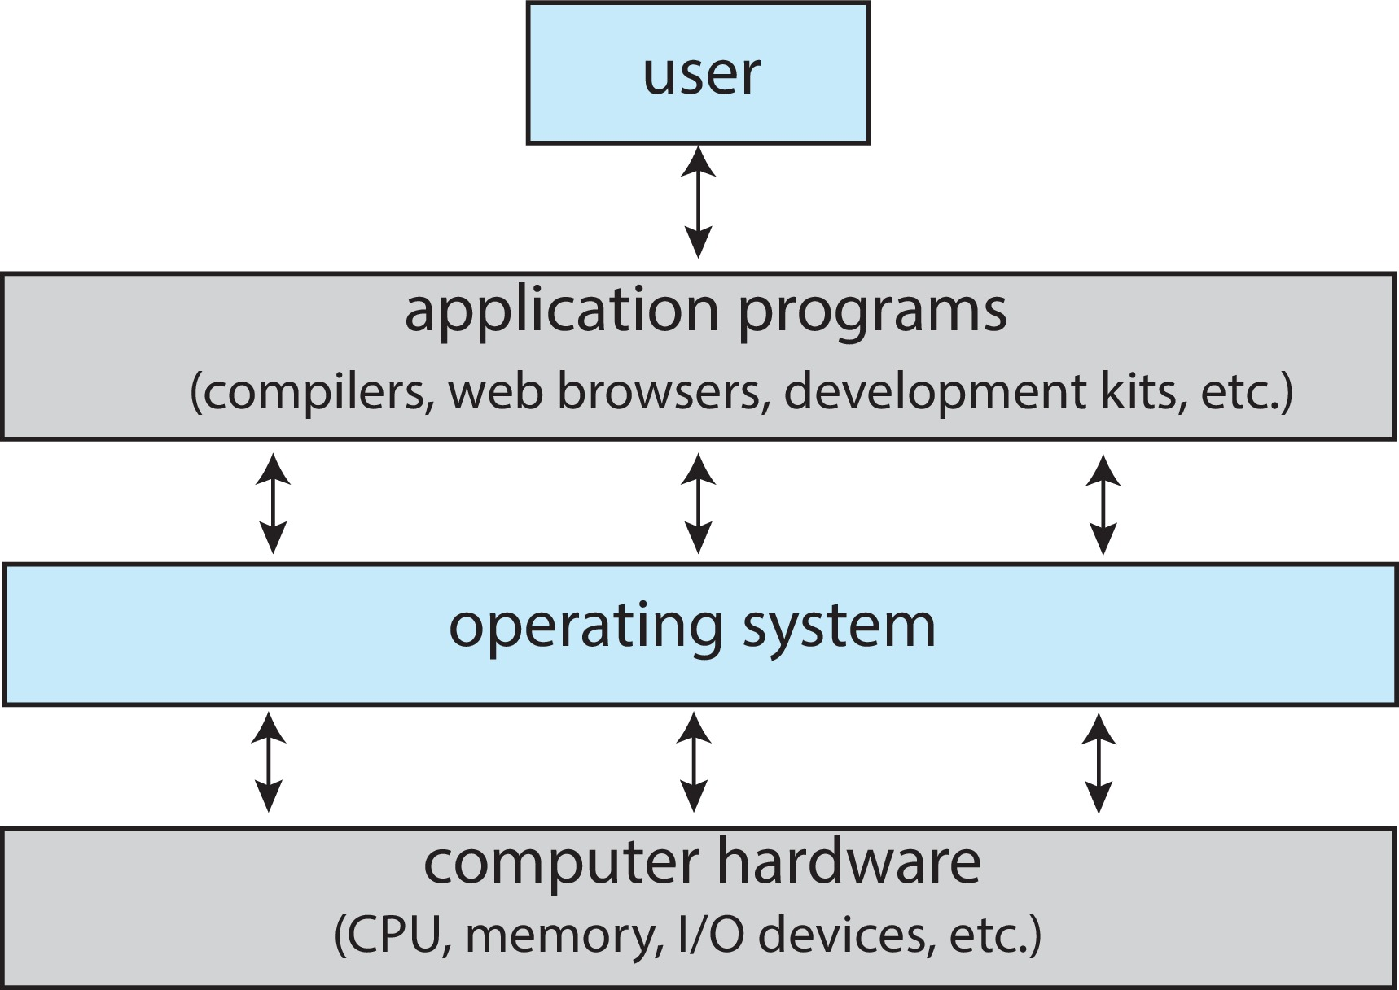
Abstract View of Components of Computer

Slide 6
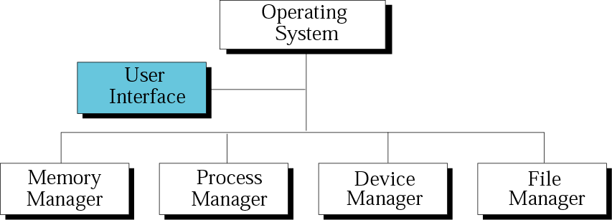
Components of an operating system

Slide 7
Process Management
Main Memory Management
File Management
I/O System Management
Networking
Protection System
Command-Interpreter System

Slide 8
Process Management
Manage the multiple processes running simultaneously on the OS
Ensures that all running processes (tasks) are executed efficiently, resources are shared fairly, and everything happens without chaos.

Slide 9
Main Memory Management
Allocation/de-allocation for processes, files, I/O.
Maintenance of several processes at a time
Keep track of who's using what memory
Movement of process memory to/from secondary storage.
Analogous to manager in a hotel.

Slide 10
File Management
Collection of related information defined by its creator. Commonly, files represent programs (both source and object forms) and data.
Creation and deletion of files and directories.
Manipulation of files and directories.
Maps files onto secondary storage.
File backup on a stable storage media.

Slide 11
I/O System Management
I/O device management hides the variations of some hardware devices from the user
Buffers caching system
Provides general device driver code
Provides drivers for particular hardware devices.
Helps know the individualities of a device.

Slide 12
Networking
Network management helps connect the network fully or partially so that users can design routing and connection strategies with no connection and security issues
It offers user access to the various resources that the network shares.
We can access shared resources. These help speed-up computation and offer data availability and reliability.
We can access different computing resources that vary in size and function like microprocessors, minicomputers, and many general-purpose computer systems.

Slide 13
Protection System
Ensures the system is protected from unauthorized access and threats.
User authentication (e.g., passwords, biometrics).
File permissions and encryption.

Slide 14
Command-Interpreter System
Command Interpreters -- Program that accepts control statements (shell, GUI interface, etc.)
Compilers/linkers
Communications (ftp, telnet, etc.)

Slide 15
Types of Operating System
Batch OS
Multiprogramming OS
Multitasking OS
Multiprocessing OS
Realtime OS
Networking OS
Distributed OS
Embedded OS

Slide 16
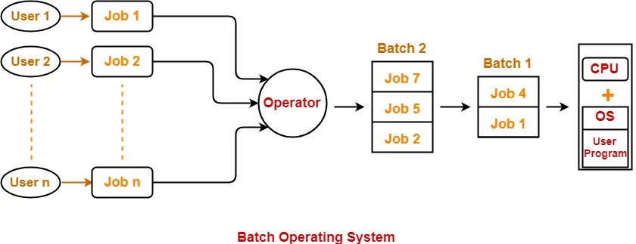
Batch OS

Slide 17
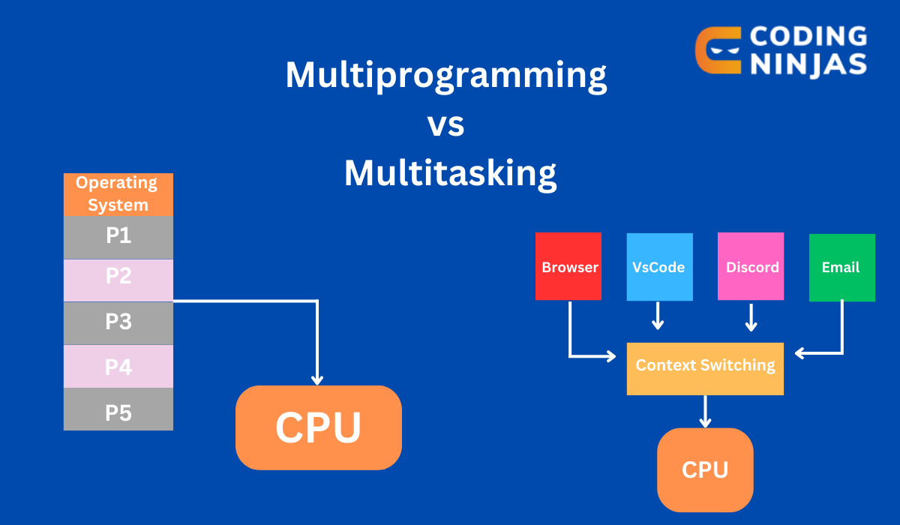
Multiprogramming and Multitasking OS
Increase CPU utilization Increase response time

Slide 18
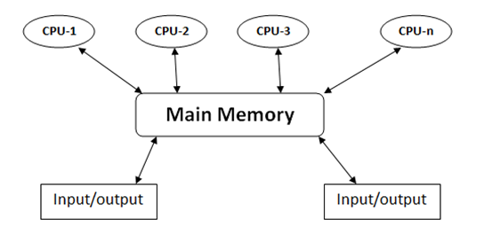
Multiprocessing OS

Slide 19
Realtime OS
OS that guarantees a response within a fixed time limit.
Hard Realtime
Soft Realtime

Slide 20
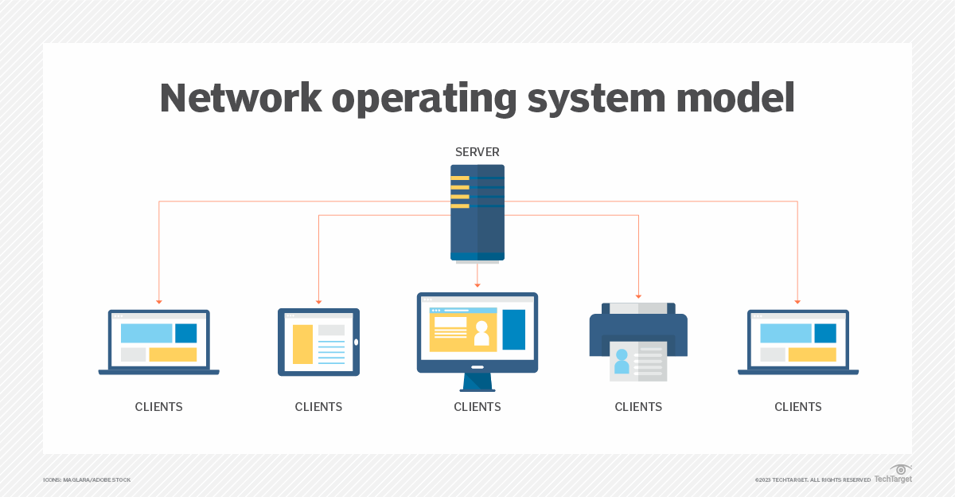
Network OS
The operating system is installed on a central server computer that controls and serves other devices.
NOS is used in a network environment
it manages the applications, users’ accounts, and system security, provides services and manages network resources for organizations.
Windows Server 2022 .

Slide 21
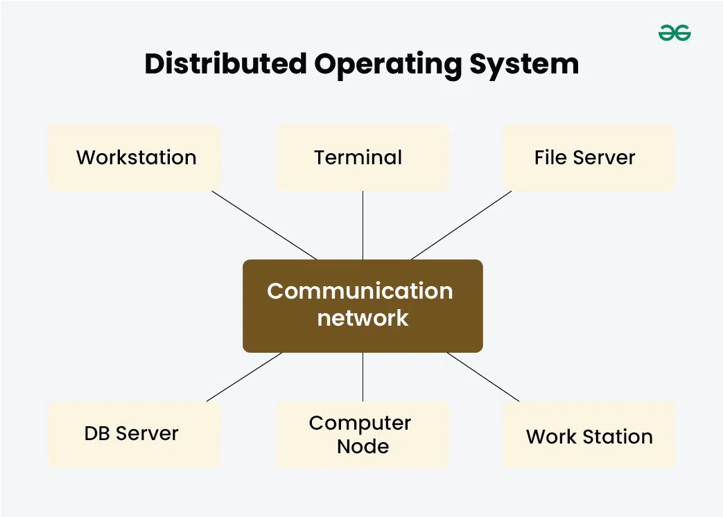
Distributed OS
applications run on multiple interconnected computers, offering enhanced communication and integration capabilities.
cloud computing platforms.
provide scalable, on-demand computing resources distributed across multiple data centers, enabling organizations to deploy and manage applications, storage, and services in a distributed manner.

Slide 22
Embedded OS
Specialized type of operating system that is designed for a specific device and function.
smart TVs, car control systems, robot control systems, Internet of Things (IoT) devices, GPS systems.

Slide 23
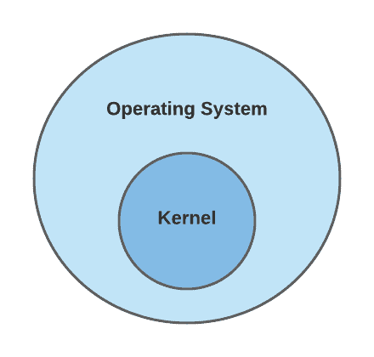
Kernel of OS
System Software
Heart and core of OS
During booting kernel is loaded from storage device to a protected memory space.
Kernel space
User space
Systemcalls

Slide 24
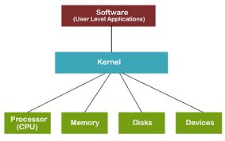
Kernel functions

Slide 25
OS Structures
Simple
Monolithic
Microkernel
Layered
Modular

Slide 26
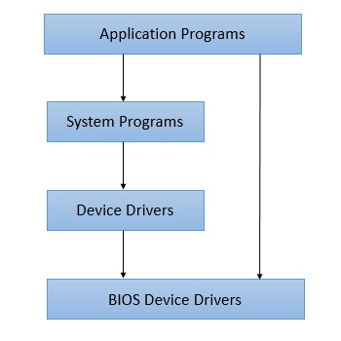
Simple
Interfaces and levels of functionality are not well separated.
MS-DOS

Slide 27
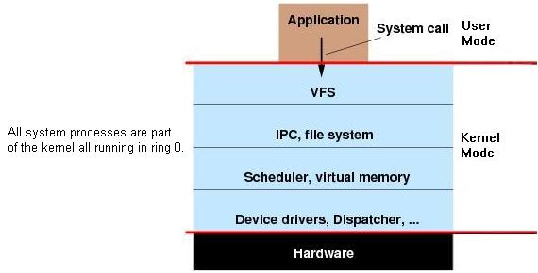
Monolithic
Entire operating system (OS) runs in a single address space, operating in kernel mode.
Single Address Space, Fast Communication, Large Size
Stability Risks, Limited Modularity

Slide 28
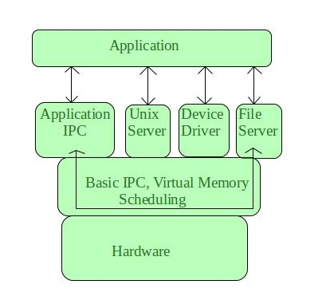
Microkernel
microkernel includes only the most essential services required to run the operating system in the kernel space, delegating other services to user space. This design aims to improve system reliability and flexibility.
Minimal Core Functionality: Only critical services like inter-process communication (IPC), basic memory management, and CPU scheduling are implemented in the kernel space.
User Space Services: Non-essential services like device drivers, file systems, and network protocols are implemented as user-space processes.
Modularity: The modular design makes the microkernel easy to maintain, update, and debug.
Message Passing: Communication between the kernel and user-space services happens through message passing, which provides a clear separation between components.
Fault Isolation: Since most services run in user space, a failure in one service is less likely to crash the entire system.

Slide 29
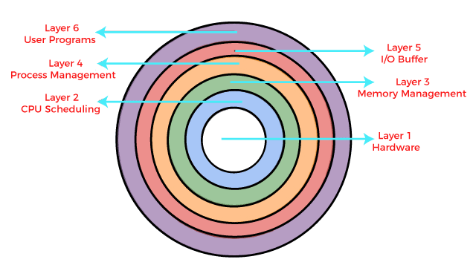
Layered
Organizes the system into a series of hierarchical layers, each built on top of the other.
Each layer provides specific functionalities and interacts only with the layer directly above or below it.

Slide 30
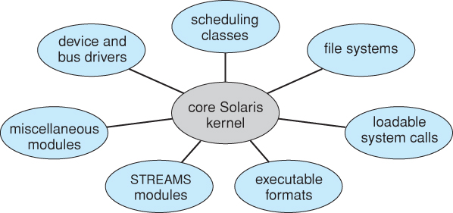
Modular
Modern OS development is object-oriented, with a relatively small core kernel and a set of modules which can be linked in dynamically.
for example, the Solaris structure.
Modules are similar to layers in that each subsystem has clearly defined tasks and interfaces, but any module is free to contact any other module, eliminating the problems of going through multiple intermediary layers.
The kernel is relatively small in this architecture, similar to microkernels, but the kernel does not have to implement message passing since modules are free to contact each other directly.

